Slide 1
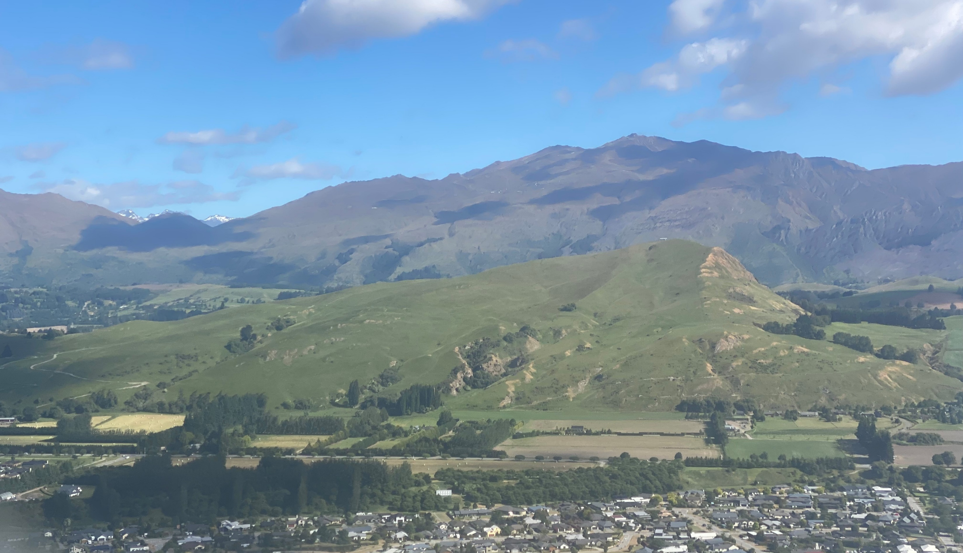
Te Pūtahi Ladies Mile Variation – Queenstown
December 2023 | Presentation to Hearing Panel

Slide 2
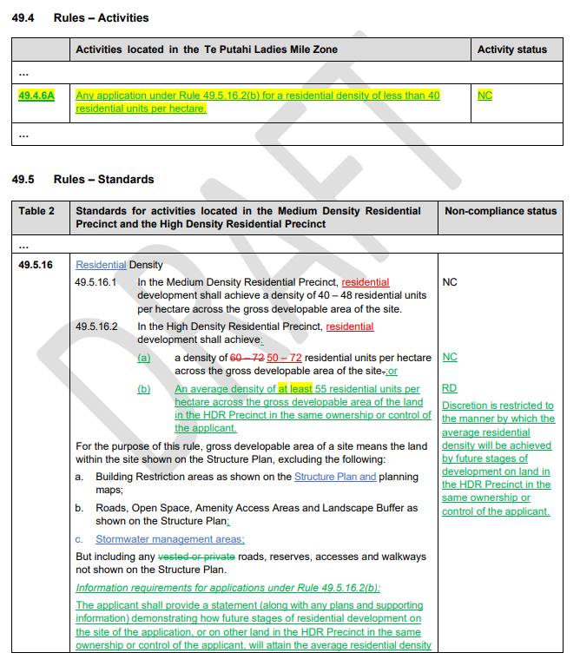
Amend 49.5.16.2(a) to read:
…”40-72 residential units per hectare…”
HDR Precinct – Density Provisions

Slide 3
Table 2 | Standards for activities located in the MDRP and HDRP |  | Non-compliance status
49.5.37 | Residential Visitor Accommodation in the HDR Precinct, where: |  | RD Discretion is restricted to: The location, nature and scale of activities; Vehicle access and parking; Privacy and overlooking; Outdoor lighting; The management of noise, rubbish, recycling and outdoor activities; Guest management and complaints procedures; The keeping of records of the RVA use, and availability of records for council inspection; and Monitoring requirements, including imposition of an annual monitoring charge.
 | 49.5.37.1 | The activity is in a building of at least four storeys;
 | 49.5.37.2 | The total nights of occupation by paying guests within a unit does not exceed a cumulative total of 90 nights per annum from the date of initial registration.
 | 49.5.37.3 | The number of guests must not exceed two adults per bedroom and the total number of adults and children must not exceed: 3 in a one-bedroom residential unit; 6 in a two-bedroom residential unit; 9 in a three-bedroom residential unit
 | 49.5.37.4 | No vehicle movements by a passenger service vehicle capable of carrying more than 12 people are generated.
Residential Visitor Accommodation Provisions

Slide 4
Questions?
Barker & Associates
Kerikeri | Whangārei | Warkworth | Auckland | Hamilton | Cambridge | Tauranga | Napier | Wellington | Christchurch | Queenstown | Wānaka

